Slide 1
Neural Networks
Course 8: Q-Learning

Slide 2
Overview
What is reinforcement learning
Basic Reinforcement Learning
Q - Learning
Reinforcement Learning using Neural Networks
Questions

Slide 3
What is reinforcement learning?

Slide 4
What is reinforcement learning?
Reinforcement learning is learning what to do--how to map situations to actions--so as to maximize a numerical reward signal
The learner is not told which actions to take
He receives rewards or penalties for each actions he takes
Through trial and error he must find a strategy that maximizes the reward
It is not specific to neural nets, but neural nets can be used in this kind of learning
Differences to supervised learning:
No labeled data
Feedback may be delayed
The agent affects the environment

Slide 5
What is reinforcement learning?
Examples of reinforcement learning:
Make a robot walk
Play Atari Games
Beat world champion at Backgammon game
Invest in the stock market
Make an helicopter perform stunts

Slide 6

Basic Reinforcement Learning
The agent does the following steps:
Observes the environment
Takes an action
Receive reward
Learn
Repeat
World
Receive reward
Take action
Observe state
The purpose is to find a policy that maximizes the total reward over the lifetime of the agent

Slide 7
Basic Reinforcement Learning
Markov Decision Process: Making a single decision:
Agent is in state 0
Action A, takes him to State 1, reward is 3
Action B, takes him to State 2, reward is 2
If Goal is to maximize reward, than the answer is simple:
Take action with the highest reward (A)
1
A
3
0
B
2
2

Slide 8
Basic Reinforcement Learning
Markov Decision Process: Making multiple decisions:
This can be generalized. Every action affects subsequent actions.
A
1
1
3
1
1
B
A
A
1
5
0
B
2
-1000
4
10
2
A
A

Slide 9
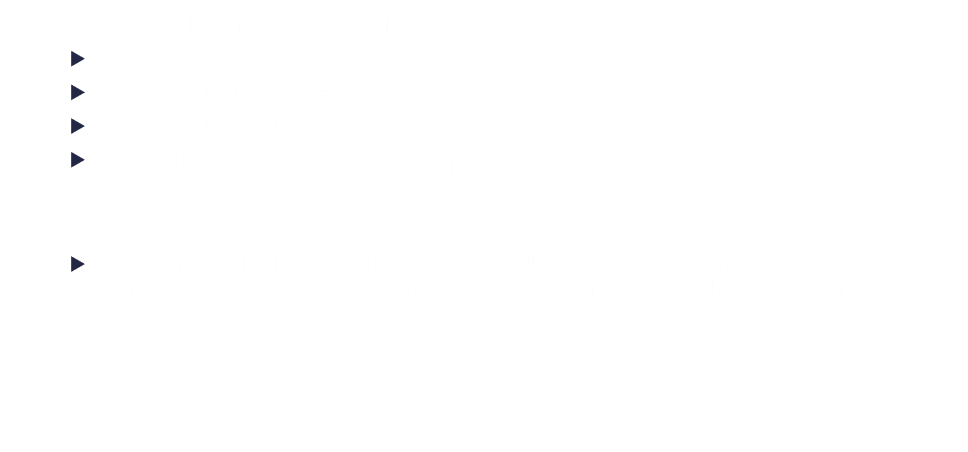
Basic Reinforcement Learning
A Markov Decision Process is:
A set of states, $S=\left\{s_{1}, s_{2}, …, s_{n}\right\}$
A set of actions, $A=\{a_{1},a_{2},…a_{m}\}$
A reward function, $R=S×A×S→ℝ$
A transition function: $P_{ij}^{a}=P\left(s_{t+1}=j\right|s_{t}=i, a_{t}=a)$
We want to learn a policy ($π)$ that will tell us what action to take in which state: $π:S→A$ in order to maximize the sum of rewards over the lifetime of the agent

Slide 10
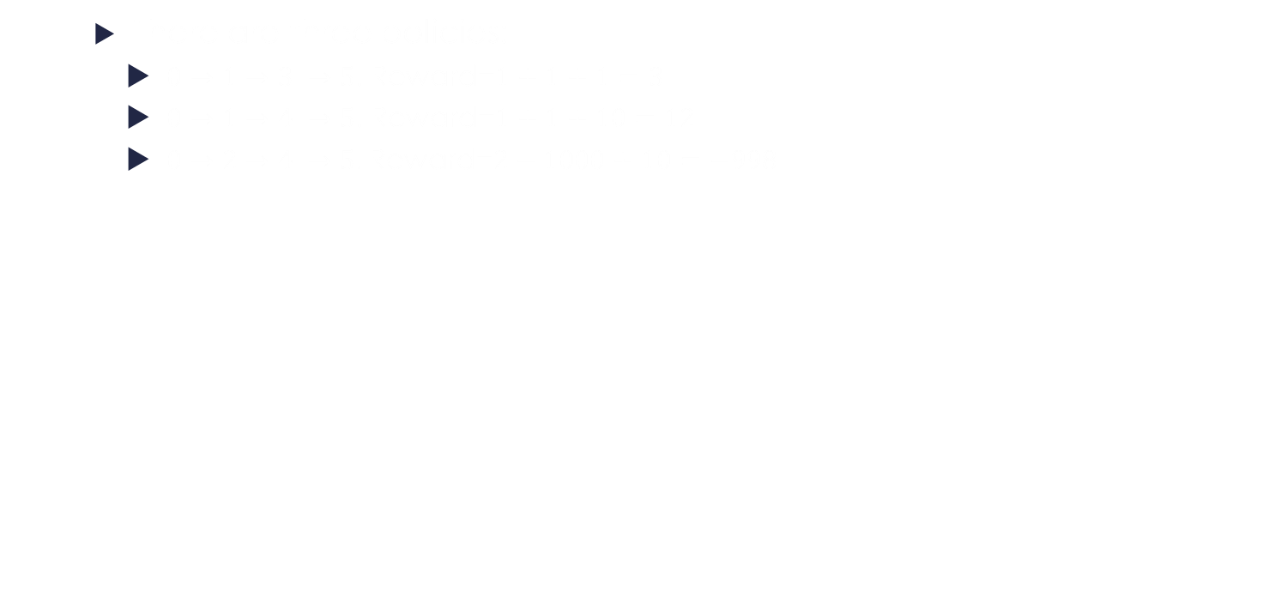
Basic Reinforcement Learning
There are three policies:
$0→1→3 →5$. Reward=$1+1+1=3$
$0→1→4 →5$. Reward=$1+1+10=12$
$0→2→4 →5.$ Reward=$2−1000+10=−998$
A
1
1
3
1
1
B
A
A
1
5
0
B
2
-1000
4
10
2
A
A

Slide 11
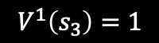
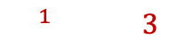
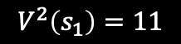
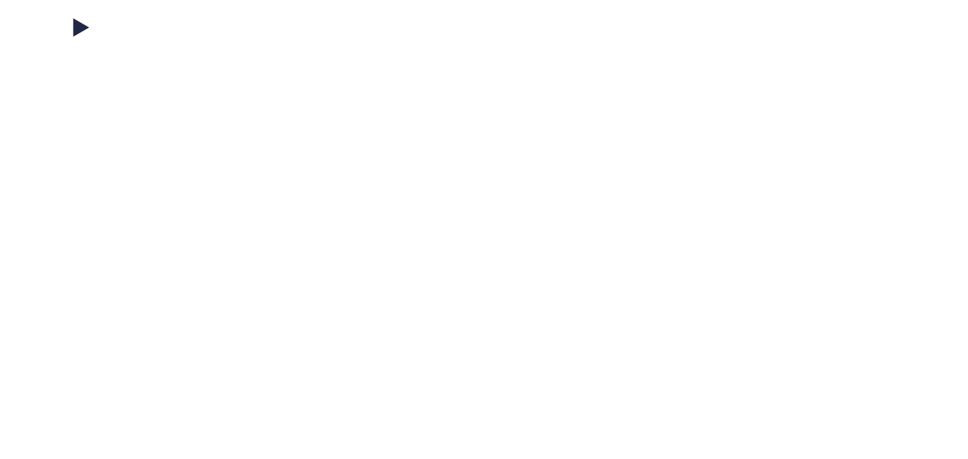
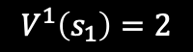
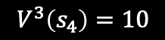
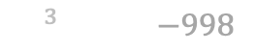
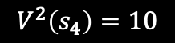
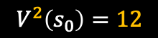
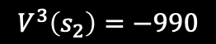
Basic Reinforcement Learning
Value Function: Associates a value with each state for a policy (How good it is to run policy $π$ from state $s$)
$V^{π}\left(s\right)=R\left(s,π\left(s\right), s^{′}\right)+V^{π}\left(s^{′}\right)$
$$V^{1}\left(s_{1}\right)=2$$
$$V^{2}\left(s_{1}\right)=11$$
$$V^{1}\left(s_{3}\right)=1$$
A
1
$$V^{1}\left(s_{0}\right)=3$$
1
3
1
$$V^{2}\left(s_{0}\right)=12$$
1
B
A
$$V^{3}\left(s_{0}\right)=−998$$
A
1
5
0
B
2
-1000
4
10
2
A
A
$$V^{3}\left(s_{2}\right)=−990$$
$$V^{2}\left(s_{4}\right)=10$$
$$V^{3}\left(s_{4}\right)=10$$

Slide 12
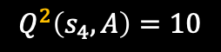
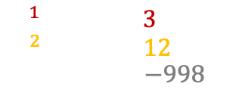
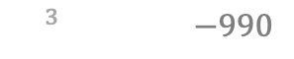
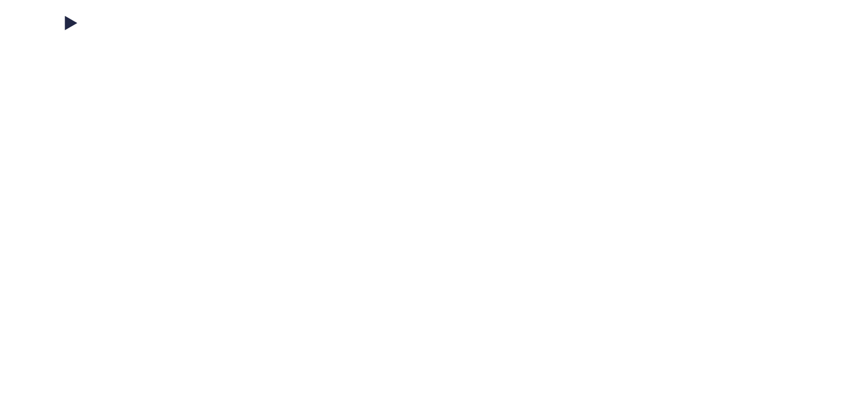
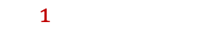
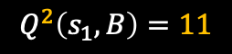
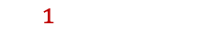
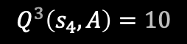
Basic Reinforcement Learning
The state-action value function, Q(s, a) gives the expected return if we start from state s, take an arbitrary action a, and then act according to the policy.
$$Q^{π}\left(s,a\right)=R\left(s,a, s^{′}\right)+{Q^{π}}_{a^{′}\sim π}^{′}\left(s^{′},a′\right)$$
$$Q^{1}\left(s_{1},A\right)=2$$
$$Q^{2}\left(s_{1},B\right)=11$$
$$Q^{1}\left(s_{3},A\right)=1$$
A
1
1
3
$$Q^{1}\left(s_{0},A\right)=3$$
$$Q^{2}\left(s_{0},A\right)=12$$
$$Q^{3}\left(s_{0},B\right)=−998$$
1
1
B
A
A
1
5
0
B
2
-1000
4
10
2
A
A
$$Q^{3}\left(s_{2},A\right)=−990$$
$$Q^{2}\left(s_{4},A\right)=10$$
$$Q^{3}\left(s_{4},A\right)=10$$

Slide 13
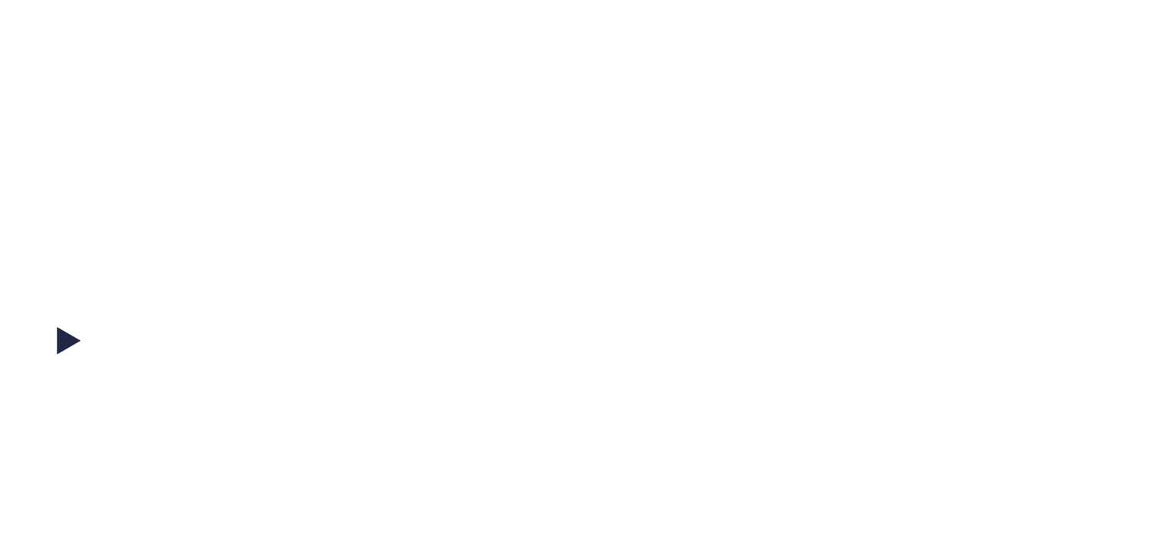
Basic Reinforcement Learning
We can also define the optimal value function. This is the maximum expected cumulative reward achievable by following the optimal policy: $π^{∗}$
$$V^{∗}\left(s\right)=\max_{a}⁡R\left(s,a,s^{′}\right)+V^{∗}\left(s^{′}\right)$$
$$Q^{∗}\left(s,a\right)=R\left(s,a,s^{′}\right)+\max_{a}{Q(s^{′},a^{′})}$$
Both tell us the same thing: Best reward + the best I can do for the next state

Slide 14
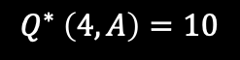
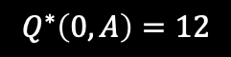
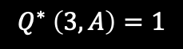
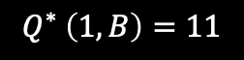
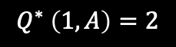
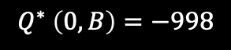
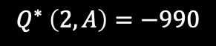
Basic Reinforcement Learning
Example of computing the optimal policy using the Q-function
$$Q^{∗} \left(1,A\right)=2$$
$$Q^{∗} \left(1,B\right)=11$$
$$Q^{∗} \left(3,A\right)=1$$
A
1
1
3
1
$$Q^{∗}\left(0,A\right)=12$$
1
B
A
$$Q^{∗} \left(0,B\right)=−998$$
A
1
5
0
B
2
-1000
4
10
2
A
A
$$Q^{∗} \left(2,A\right)=−990$$
$$Q^{∗} \left(4,A\right)=10$$

Slide 15
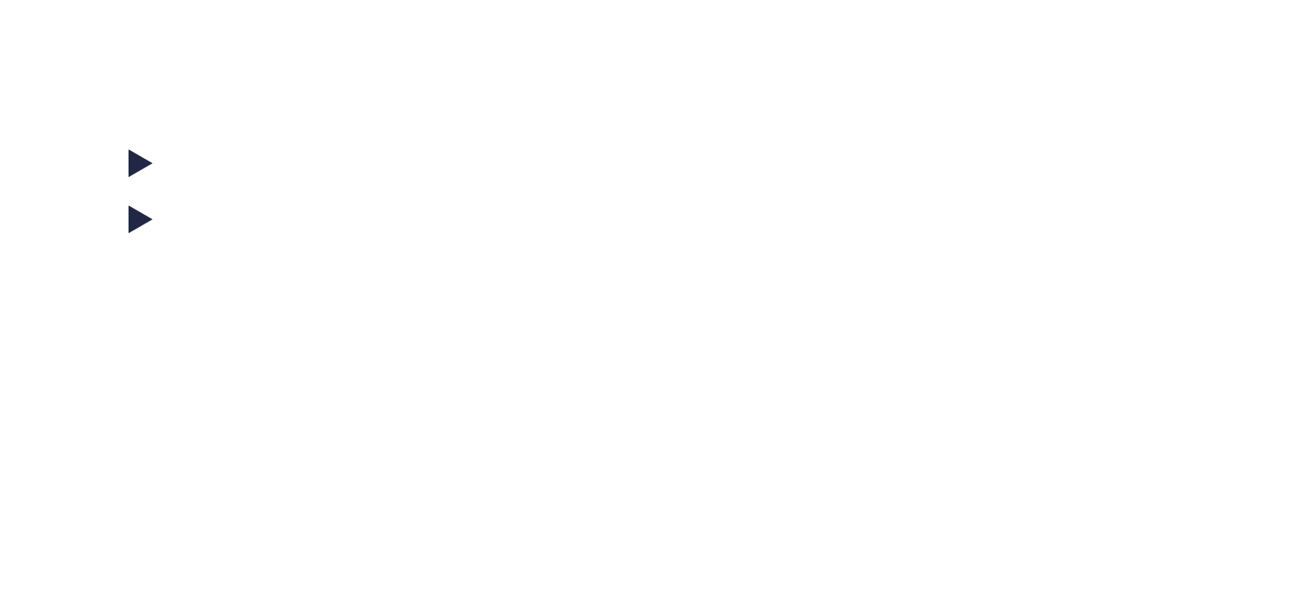
Basic Reinforcement Learning
If we have the optimal value function, then it is easy to find the policy
$π\left(s\right)=\arg{\max_{a}{(R\left(s,a,s^{′}\right)+V^{∗}\left(s^{′}\right))}}$
$π\left(s\right)=\arg{\max_{a}{Q^{∗}(s,a)}}$
So, the easiest way to find the policy is to first find the value function

Slide 16
Basic Reinforcement Learning
1
More complex MDPs:
In this case, the number of steps is unlimited
The value of states 1 or 2 can be infinite
All policies with non-zero reward cycle have
infinite value
A
1
B
A
0
-1000
3
0
B
0
1000
2
B
A
1

Slide 17
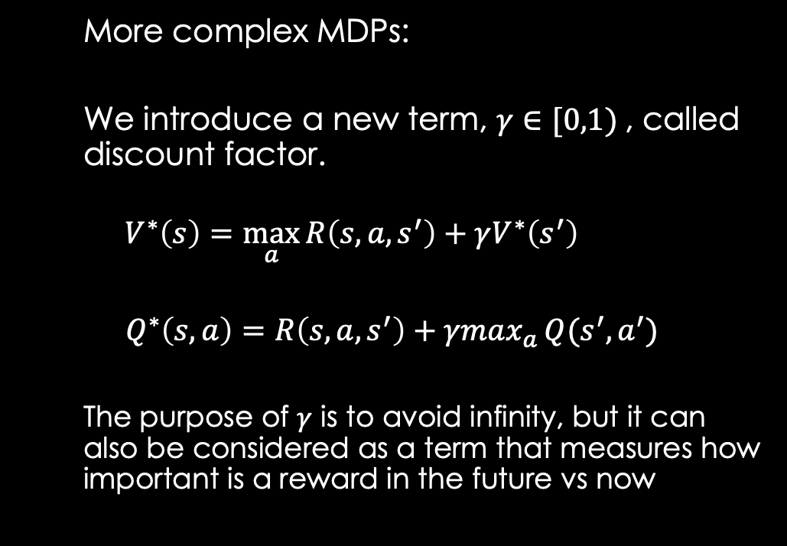
Basic Reinforcement Learning
More complex MDPs:
We introduce a new term, $γ∈[0,1)$, called discount factor.
$$V^{∗}\left(s\right)=\max_{a}⁡R\left(s,a,s^{′}\right)+γV^{∗}\left(s^{′}\right)$$
$Q^{∗}\left(s,a\right)=R\left(s,a,s^{′}\right)+γmax_{a}{Q(s^{′},a^{′})}$
The purpose of $γ$ is to avoid infinity, but it can also be considered as a term that measures how important is a reward in the future vs now
1
A
1
B
A
0
-1000
3
0
B
0
1000
2
B
A
1

Slide 18


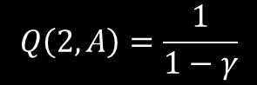
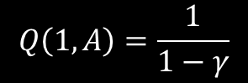

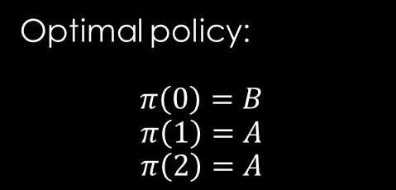
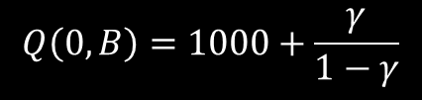
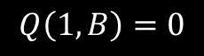
Basic Reinforcement Learning
$$Q\left(1,B\right)=0$$
$$Q\left(1,A\right)=1+γQ\left(1,A\right)→Q\left(1,A\right)=\frac{1}{1−γ}$$
1
$$Q\left(1,A\right)=\frac{1}{1−γ}$$
A
1
B
$$Q\left(0,A\right)=−1000+\frac{γ}{1−γ}$$
A
0
-1000
3
0
$$Q\left(0,B\right)=1000+\frac{γ}{1−γ}$$
B
0
1000
2
Optimal policy:
$$π\left(0\right)=B$$
$$π\left(1\right)=A$$
$$π\left(2\right)=A$$
B
$$Q\left(2,A\right)=\frac{1}{1−γ}$$
A
$$Q\left(2,B\right)=0$$
1
Notes:
Spune aici ca Q(0,A) este reward-ul imediat + Q(1, A). Iar apoi mergi si calculeaza q(1, a)
Explica apoi ca poti comapra cele 2 intre ele

Slide 19
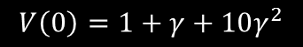
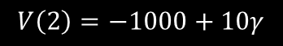
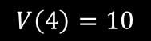

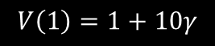
Basic Reinforcement Learning
If the MDP model is complete, we can compute the optimal value function directly, through dynamic programming (recursive)
$$V\left(1\right)=1+10γ$$
$$V(3)=1$$
A
1
1
3
1
1
B
$$V\left(0\right)=1+γ+10γ^{2}$$
A
1
5
0
0
B
A
2
-1000
4
10
2
A
A
$$V\left(2\right)=−1000+10γ$$
$$V\left(4\right)=10$$
Notes:
MDP e complet daca stim tranzitiile si reward-ul pentru fiecare stare.

Slide 20
Basic Reinforcement Learning
What happens when we don’t have a complete MDP:
We know the states and actions
We don’t have the system model (no transition function or reward function)
We are allowed to sample from the MDP.
We must perform actions in order to generate experiences (s,a,r,s’). Based on a (large) number of experiences we can approximate the transition function and the reward function
This is called reinforcement learning

Slide 21
Basic Reinforcement Learning
Monte Carlo Method:
The Monte Carlo method is a computational technique that uses random sampling to solve mathematical or physical problems that might be difficult or impossible to solve exactly.
In Monte Carlo Reinforcement Learning (MC RL), the algorithm:
Runs complete episodes (like repeated “plays” of a game),
Observes returns,
Uses the average of many random trajectories to estimate value functions.
Notes:
In the 1940s, scientists working on the Manhattan Project (notably Stanislaw Ulam and John von Neumann) were trying to model complex nuclear processes that involved randomness. Ulam, recovering from an illness, found himself thinking about solitaire card games and how hard it would be to compute their probabilities exactly. But he realized:
You could estimate the solution by playing the game repeatedly and observing the outcomes.
This idea—using random sampling to approximate a solution—matched how gambling games work.
Because Ulam’s uncle was known for gambling at the Monte Carlo casino, the team jokingly called the method the "Monte Carlo method." The name stuck.

Slide 22
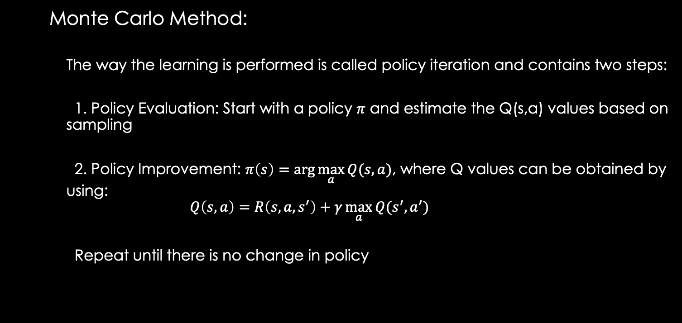
Basic Reinforcement Learning
Monte Carlo Method:
The way the learning is performed is called policy iteration and contains two steps:
1. Policy Evaluation: Start with a policy $π$ and estimate the Q(s,a) values based on sampling
2. Policy Improvement: $π\left(s\right)=\arg{\max_{a}{Q(s,a)}}$, where Q values can be obtained by using:
$$Q\left(s,a\right)=R\left(s,a,s^{′}\right)+γ\max_{a}{Q(s^{′},a^{′})}$$
Repeat until there is no change in policy
Notes:
Practic metoda spone sa obtin niste estimari a functiei Q intr-un anumit punct, iar apoi intotdeauna aleg varianta cea mai buna, imbunatatind aproximarea pe fiecare drum

Slide 23
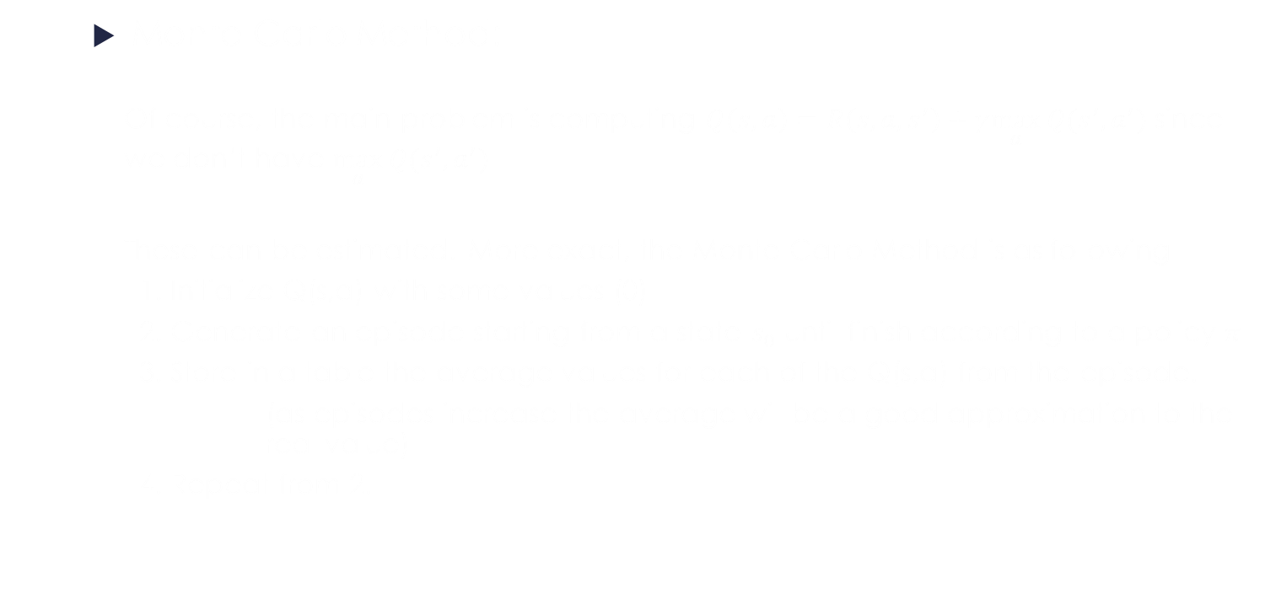
Basic Reinforcement Learning
Monte Carlo Method:
Of course, the main problem is computing $Q\left(s,a\right)=R\left(s,a,s^{′}\right)+γ\max_{a}{Q(s^{′},a^{′})}$ since we don’t have $\max_{a}{Q(s^{′},a^{′})}$
These can be estimated. More exact, the Monte Carlo Method is as following
1. Initialize Q(s,a) with some values (0)
2. Generate an episode starting from a state $s_{0}$ until finish according to a policy $π$
3. Store in a table the average values for each of the Q(s,a) from the episode.
(as episodes increase the average will be a good approximation to the real value)
4. Repeat from 2.

Slide 24
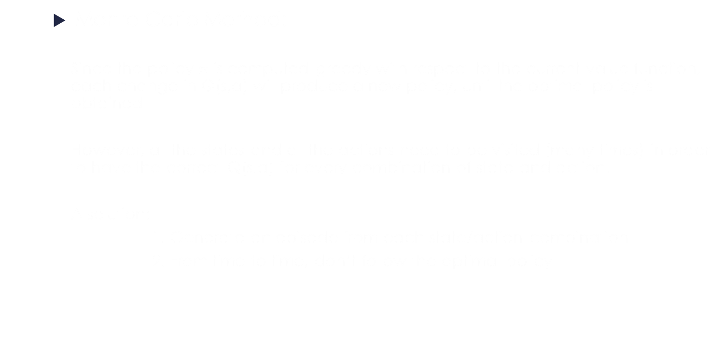
Basic Reinforcement Learning
Monte Carlo Method:
Since the policy $π$ is computed greedy with respect to the current value function, each change in Q(s,a) will produce a new policy, until the optimal policy is obtained
However, all the states and all the actions need to be visited (many times) in order to have the correct Q(s,a) for every combination of state and action.
A solution:
1. Generate an episode from each state/action combination
2. From time to time, don’t follow the optimal policy

Slide 25
Basic Reinforcement Learning
Example: Black Jack Game
Rules of blackjack:
There is a dealer and a player
Each player is dealt 2 cards. Face-up. The dealer is dealt two cards, one face-up, one face-down
The goal is to get the sum of your cards, as close to 21 as possible but don’t go over 21
Cards value(2-9 their number, J, Q, K -10 points)
An ace can be considered a 1 or a 10
You have two actions possible: stay or hit
The dealer always follows this policy: hit until cards sum 17 or more then stay
The player closer to 21 wins. The one over 21, loses

Slide 26
Basic Reinforcement Learning
What is the state:
Sum of the player’s cards
If the players has an usable ace
Sum of the dealer’s cards
If the dealer has an usable ace
What are the actions:
Deal
Stay
What are the rewards:
Win: 1
Lose: -1
Draw: 0

Slide 27
Basic Reinforcement Learning
Example: Black Jack Game
We will learn the best strategy (policy), by running the blackjack many times and averaging the results for each state/action combination
The states/actions (Q(s,a)) will be stored in a table (python dictionary)

Slide 28
Basic Reinforcement Learning
Example: Black Jack Game
Let’s say that the game is in the following state:
The sum of the player’s card is 18
The card that the dealer shows is 9
This is a difficult position, since:
There is a high probability that the other card of the dealer is 10 points
But if the player chooses to hit, it is a high probability that he will go over 21

Slide 29
Basic Reinforcement Learning
Observe how the rewards stabilize over time
So, the best actions to take is to stay, since it is less likely to lose (-0.2) than if he would hit (-0.5)

Slide 30
Basic Reinforcement Learning
In the same way, all Q-values can be computed for every possible combination and a proper decision can be taken
 | 1 |  | 2 |  | 3 |  | 4 |  | 5 |  | 6 |  | 7 |  | 8 |  | 9 |  | 10
 | stay | hit | stay | hit | stay | hit | stay | hit | stay | hit | stay | hit | stay | hit | stay | hit | stay | hit | stay | hit
11 | -0.76 | -0.12 | -0.29 | 0.21 | -0.24 | 0.23 | -0.21 | 0.26 | -0.19 | 0.29 | -0.15 | 0.31 | -0.53 | 0.27 | -0.5 | 0.2 | -0.6 | 0.13 | -0.58 | 0.04
12 | -0.78 | -0.54 | -0.29 | -0.3 | -0.24 | -0.25 | -0.21 | -0.22 | -0.16 | -0.22 | -0.14 | -0.19 | -0.44 | -0.24 | -0.49 | -0.29 | -0.59 | -0.36 | -0.59 | -0.43
13 | -0.77 | -0.57 | -0.29 | -0.32 | -0.26 | -0.32 | -0.21 | -0.31 | -0.17 | -0.25 | -0.16 | -0.28 | -0.47 | -0.29 | -0.52 | -0.34 | -0.52 | -0.41 | -0.57 | -0.48
14 | -0.78 | -0.59 | -0.29 | -0.33 | -0.25 | -0.35 | -0.21 | -0.35 | -0.17 | -0.31 | -0.15 | -0.31 | -0.5 | -0.35 | -0.49 | -0.39 | -0.52 | -0.45 | -0.58 | -0.51
15 | -0.8 | -0.63 | -0.29 | -0.41 | -0.25 | -0.42 | -0.21 | -0.38 | -0.17 | -0.42 | -0.17 | -0.39 | -0.47 | -0.4 | -0.5 | -0.44 | -0.56 | -0.48 | -0.58 | -0.55
16 | -0.76 | -0.65 | -0.3 | -0.5 | -0.25 | -0.46 | -0.21 | -0.45 | -0.17 | -0.43 | -0.15 | -0.43 | -0.46 | -0.43 | -0.54 | -0.47 | -0.56 | -0.52 | -0.57 | -0.59
17 | -0.64 | -0.67 | -0.15 | -0.55 | -0.12 | -0.58 | -0.08 | -0.51 | -0.04 | -0.53 | 0.01 | -0.5 | -0.1 | -0.5 | -0.39 | -0.54 | -0.43 | -0.58 | -0.47 | -0.64
18 | -0.38 | -0.72 | 0.12 | -0.63 | 0.15 | -0.59 | 0.17 | -0.62 | 0.2 | -0.62 | 0.29 | -0.63 | 0.39 | -0.59 | 0.11 | -0.63 | -0.19 | -0.62 | -0.24 | -0.67
19 | -0.12 | -0.79 | 0.39 | -0.74 | 0.41 | -0.75 | 0.42 | -0.73 | 0.45 | -0.73 | 0.5 | -0.7 | 0.61 | -0.72 | 0.59 | -0.73 | 0.29 | -0.7 | -0.02 | -0.75
20 | 0.15 | -0.89 | 0.64 | -0.85 | 0.64 | -0.85 | 0.66 | -0.85 | 0.67 | -0.85 | 0.7 | -0.84 | 0.77 | -0.87 | 0.79 | -0.86 | 0.75 | -0.85 | 0.43 | -0.86

Slide 31
Basic Reinforcement Learning
Disadvantages for Monte Carlo:
The algorithm needs to reach the final reward in order to update all the rewards)
If the rewards have high variance, the convergence is slow
The number of states and actions must be small so they can fit in a table
The algorithm needs to evaluate a long trajectory just to update the starting state-action pair

Slide 32
Q-Learning

Slide 33
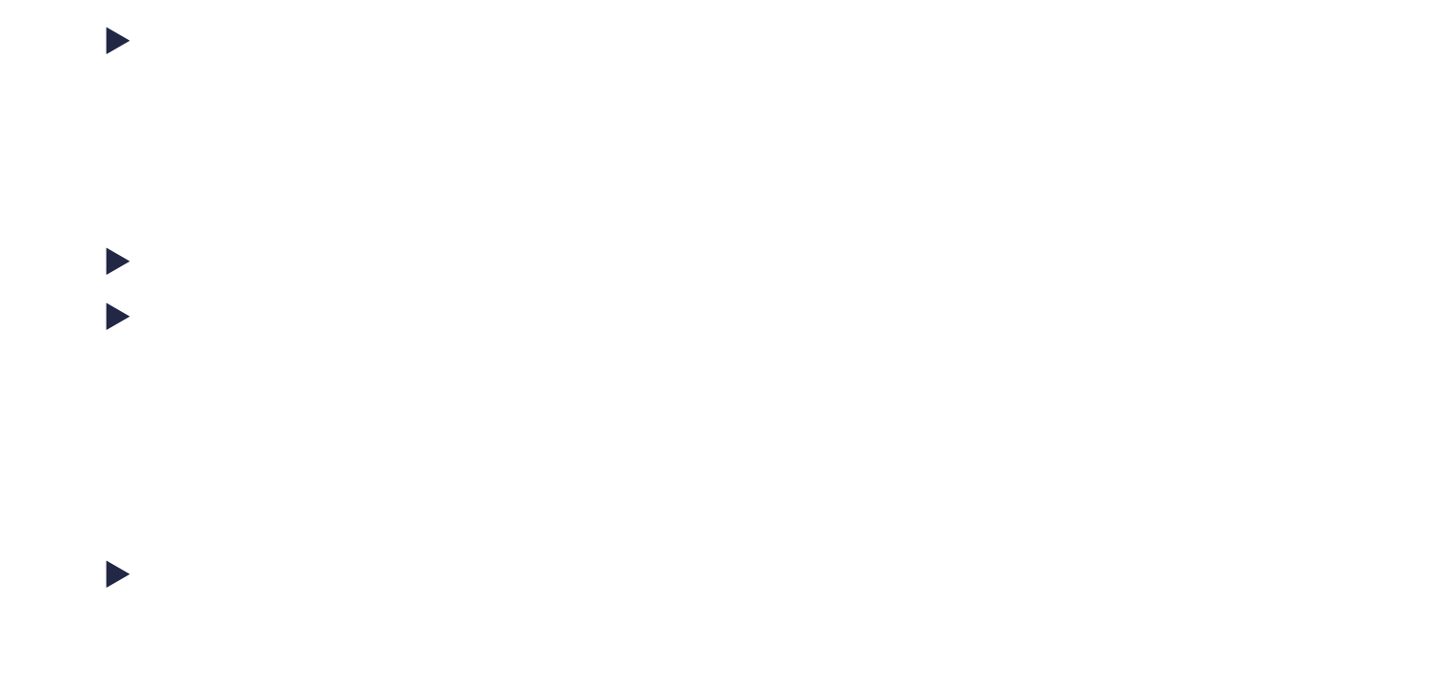
Q-Learning
As with Monte-Carlo, Q-learning tries to predict the value for every Q(s,a) in order to be able to compute:
$Q\left(s,a\right)=R\left(s,a,s^{′}\right)+γ\max_{a}{Q(s^{′},a^{′})}$
Let’s suppose that we have all the predictions in a table Q.
We don’t know how correct are those but it’s the only ones we have.
We’ll note $Q^{p}(s,a)$ the prediction of $Q(s,a)$
The idea of Q-learning is to first take an action, see the reward and correct the old prediction

Slide 34
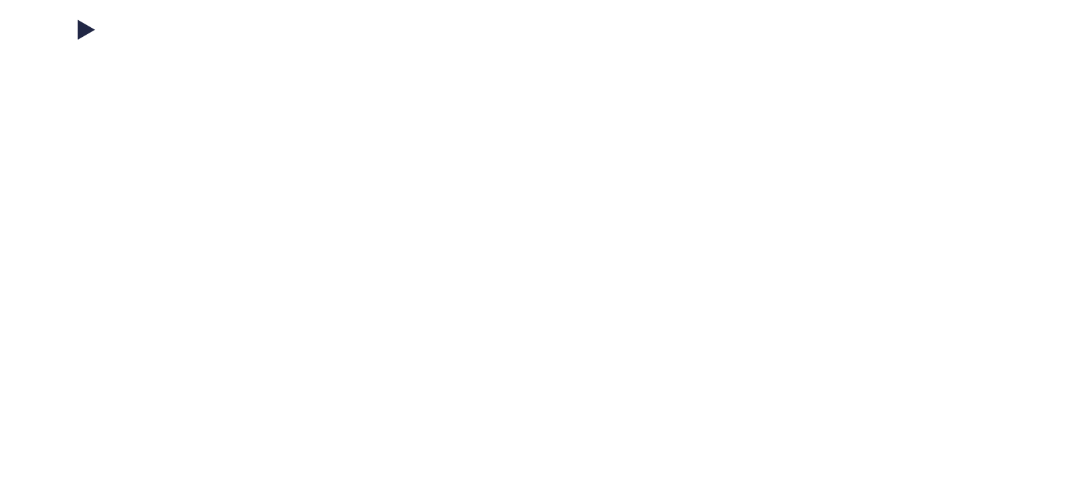
Q-Learning
As stated earlier, the $γ$ factor tells us how important is the reward in the future vs now.
$$Q\left(s,a\right)=R\left(s,a,s^{′}\right)+γ\max_{a}{Q(s^{′},a^{′})}$$
Let’s suppose that $γ=0$. So, we are only interested in immediate rewards.
When we have to take an action, we look of all $Q^{p}\left(s,a\right)$ values from our prediction table(we only have predictions) and take the corresponding action that takes as to a new state $s′$ and gives us a reward $R(s,a,s^{′})$

Slide 35
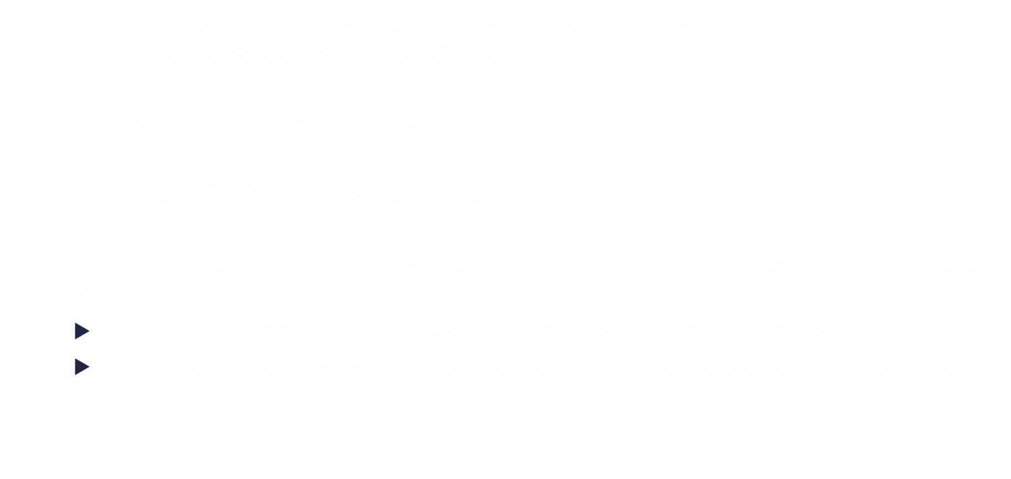
Q-Learning
Since we’ve got our immediate reward, we can compare it to our prediction and adjust the prediction.
$Q^{p}\left(s,a\right)=Q^{p}\left(s,a\right)+α( R\left(s,a,s^{′}\right)−Q^{p}\left(s,a\right))$
Where $α∈[0,1]$ is the learning rate
The learning rate tell us how quickly we want to incorporate the new date in our prediction:
if $α=1$ then we want our prediction to be equal to the Reward
if $α∈(0,1)$ then we want more rewards in order to better estimate the prediction

Slide 36
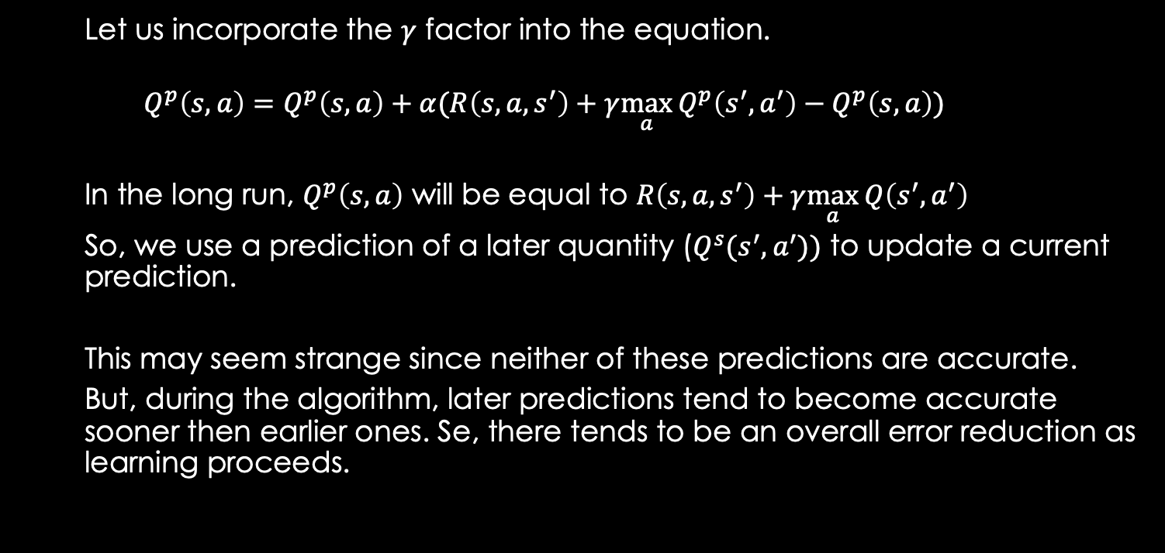
Q-Learning
Let us incorporate the $γ$ factor into the equation.
$$Q^{p}\left(s,a\right)=Q^{p}\left(s,a\right)+α(R\left(s,a,s^{′}\right)+γ\max_{a}{Q^{p}\left(s^{′},a^{′}\right)}−Q^{p}\left(s,a\right))$$
In the long run, $Q^{p}\left(s, a\right)$ will be equal to $R\left(s,a,s^{′}\right)+γ\max_{a}{Q\left(s^{′},a^{′}\right)}$
So, we use a prediction of a later quantity ($Q^{s}(s^{′},a^{′}))$ to update a current prediction.
This may seem strange since neither of these predictions are accurate.
But, during the algorithm, later predictions tend to become accurate sooner then earlier ones. Se, there tends to be an overall error reduction as learning proceeds.

Slide 37
Reinforcement Learning using Neural Networks

Slide 38
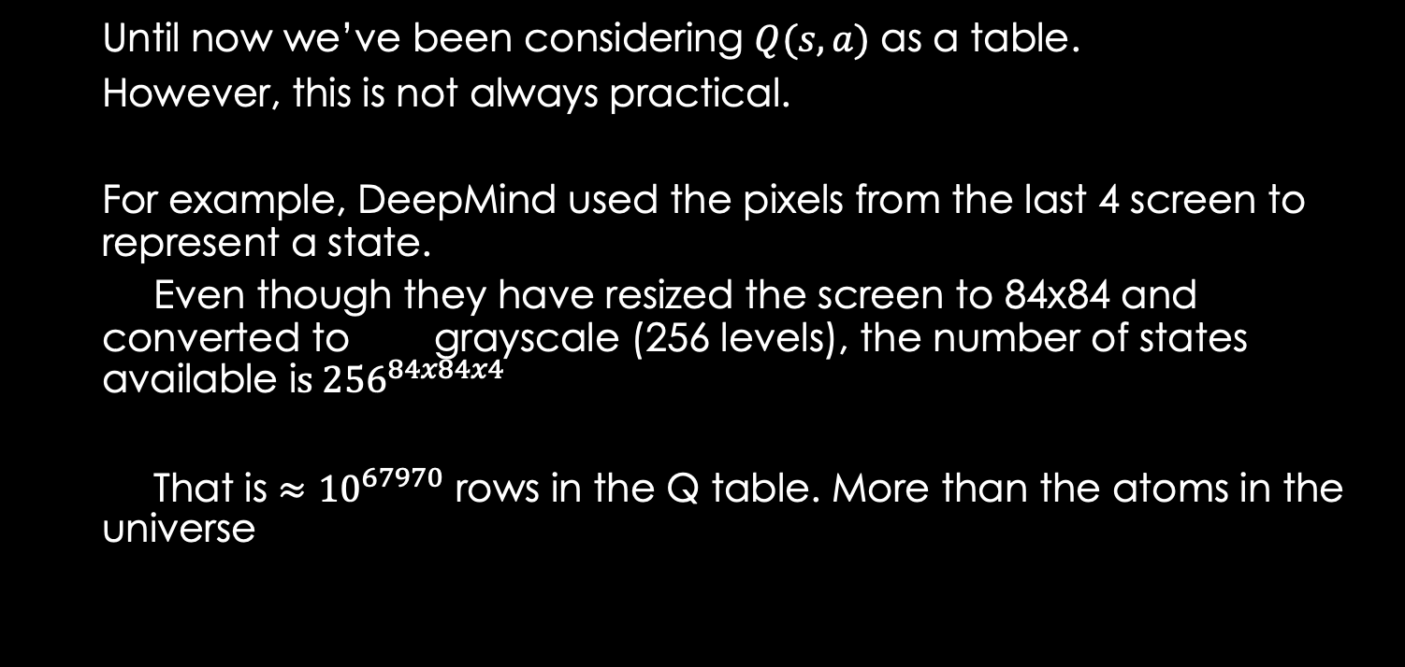
Reinforcement Learning using Neural Networks
Until now we’ve been considering $Q(s,a)$ as a table.
However, this is not always practical.
For example, DeepMind used the pixels from the last 4 screen to represent a state.
Even though they have resized the screen to 84x84 and converted to grayscale (256 levels), the number of states available i$s {256}^{84x84x4}$
That is $≈{10}^{67970}$ rows in the Q table. More than the atoms in the universe

Slide 39
Reinforcement Learning using Neural Networks
This is where Neural Networks come in.
Neural Networks are good at approximating values.
So, we’ll use neural networks to approximate Q(s,a).
So, like in the case of Atari games, there won’t be much of a problem if a state is approximated (i.e. states that are different only by a bunch of pixels could have the same value)
But how do we train the network? What is our target value?

Slide 40
Reinforcement Learning using Neural Networks
We will use a neural network that will simulate the Q(s,a) function.
The network will receive as input:
s: state
a: action
Will output the Q(s,a) function. Since we want to take the path where Q(s,a) has the greatest value, we need to compute Q(s,a) for all the actions(a) available in the state s.
Q-value
Network – hidden layers
action
state

Slide 41
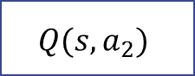
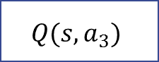
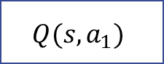
Reinforcement Learning using Neural Networks
We can improve the architecture of our neural network, by modifying the output shape
Instead of doing a forward pass for each state/action combination, we modify our network to have an output for each action.
This way, we only need a forward pass for each action
$$Q(s,a_{1})$$
$$Q(s,a_{2})$$
$$Q(s,a_{3})$$
Q-value
Network – hidden layers
Network – hidden layers
action
state
state

Slide 42

Reinforcement Learning using Neural Networks
How will we train this network?
In the case of Q-learning:
$$Q^{}\left(s,a\right)=Q^{}\left(s,a\right)+α(R\left(s,a,s^{′}\right)+γ\max_{a′}{Q^{}\left(s^{′},a^{′}\right)}−Q^{}\left(s,a\right))$$
We‘ve arrived at this equation by wanting to make $Q(s,a)$ be more like $R\left(s,a,s^{′}\right)+γ\max_{a′}{Q(s^{′},a^{′})}$
So, we’ll train our neural network by using the loss
* the prediction of the network: Q(s,a) for the action we’ve taken
* the target value $R\left(s,a,s^{′}\right)+γ\max_{a′}{Q(s^{′},a^{′})}$

Slide 43




Reinforcement Learning using Neural Networks
We’ll construct the target value $t_{s}$ to be a vector that has the same number of elements as the number of possible actions.
Since we want to change the Q value only for the action we took, the target value $t_{s}$ must be
$$Q(s,a_{1})$$
$$Q(s,a_{2})$$
$$Q(s,a_{3})$$
Network – hidden layers
state
$$t_{s}=[Q\left(s,a_{1}\right), Q\left(s,a_{2}\right),…R\left(s,a_{i},s^{′}\right)+γ\max_{a′}{Q\left(s^{′},a^{′}\right),…Q(s,a_{n})]}$$

Slide 44




Reinforcement Learning using Neural Networks
$$\operatorname{argmax}{Q(s,a)}$$
Algorithm:
At each state we will :
Find the action that has the greatest Q(s,a)
a. Feed as input for the neural network the current state
b. Find the action (index) that has the greatest Q(s,a)
$$Q(s,a_{1})$$
$$Q(s,a_{2})$$
$$Q(s,a_{3})$$
Network – hidden layers
State s

Slide 45

Reinforcement Learning using Neural Networks
Algorithm:
At each state we will :
2. Take action that has the greatest Q(s,a) :
a. Get the immediate reward R
b. Move to the state that the action takes you (s’)
Take action
$$\operatorname{argmax}{Q(s,a)}$$
State s
State s’
Receive immediate reward R
$$R\left(s,a,s^{′}\right)+γ\max_{a′}{Q^{}\left(s^{′},a^{′}\right)}$$

Slide 46

Reinforcement Learning using Neural Networks
$$\max{Q(s′,a)}$$
Algorithm:
At each state we will :
3. Find the greatest value for the Q(s’,a):
a. Feed as input to the neural network the next state s’
b. Find maximum value from all the outputs of the network (actions)
$$Q(s,a_{1})$$
$$Q(s,a_{2})$$
$$Q(s,a_{3})$$
Network – hidden layers
State s
$$R\left(s,a,s^{′}\right)+γ\max_{a′}{Q^{}\left(s^{′},a^{′}\right)}$$

Slide 47





Reinforcement Learning using Neural Networks
Algorithm:
At each state we will :
4. Create the target vector based on the values we’ve discovered
5. Perform backpropagation using output from step 1 and target vector $t_{s}$
$$t_{s}=$$
$$Q(s,a_{1})$$
$$R\left(s,a,s^{′}\right)+γ\max_{a′}{Q^{}\left(s^{′},a^{′}\right)}$$
$$Q(s,a_{3})$$
Actions that were not taken. Target values are the ones obtained in step1
Action taken: target is computed based on new data (reward)
$$R\left(s,a,s^{′}\right)+γ\max_{a′}{Q^{}\left(s^{′},a^{′}\right)}$$

Slide 48

Q-Learning
Example:
You are a car and need to reach a destination (ex. the gas station)
You can move into 4 directions (← ↑ → ↓)
The car always moves (so there is no break)
There are also obstacles that the car must avoid
The car only knows what is in front and on its side (consider it is night and it can only see a limited distance that is highlighted by the headlights)

Slide 49
Q-Learning
State:
Since everything the car sees is through the headlights we can consider that the state of the car is given by the headlights.
Similar to the image on the right, we will consider the headlights to be a matrix of (20,10), centered on the car.
Each point on the matrix can be:
0 : it doesn’t intersect anything
1: it intersects the gas station
-1: it intersect an object

Slide 50

Q-Learning
State:
For the image on the right, the state will be:
0 | 0 | 0 | 0 | 0 | 0 | 0 | 0 | 0 | 0 | 0 | 0 | 0 | 0 | 0 | 0 | 0 | -1 | -1 | -1
0 | 0 | 0 | 0 | 0 | 0 | 0 | 0 | 0 | 0 | 0 | 0 | 0 | 0 | 0 | 0 | 0 | -1 | -1 | -1
0 | 0 | 0 | 0 | 0 | 0 | 0 | 0 | 0 | 0 | 0 | 0 | 0 | 0 | 0 | 0 | 0 | -1 | -1 | -1
0 | 0 | 0 | 0 | 0 | 0 | 0 | 0 | 0 | 0 | 0 | 0 | 0 | 0 | 0 | 0 | 0 | 0 | -1 | -1
0 | 0 | 0 | 0 | 0 | 0 | 0 | 0 | 0 | 0 | 0 | 0 | 0 | 0 | 0 | 0 | 0 | 0 | 0 | -1
0 | 0 | 0 | 0 | 0 | 0 | 0 | 0 | 0 | 0 | 0 | 0 | 0 | 0 | 0 | 0 | 0 | 0 | 0 | 0
0 | 0 | 0 | 0 | 0 | 0 | 0 | 0 | 0 | 0 | 0 | 0 | 0 | 0 | 0 | 0 | 0 | 0 | 0 | 0
0 | 0 | 0 | 0 | 0 | 0 | 0 | 0 | 0 | 0 | 0 | 0 | 0 | 0 | 0 | 0 | 0 | 0 | 0 | 0
0 | 0 | 0 | 0 | 0 | 0 | 0 | 0 | 0 | 0 | 0 | 0 | 0 | 0 | 0 | 0 | 0 | 0 | 0 | 0
0 | 0 | 0 | 0 | 0 | 0 | 0 | 0 | 0 | 0 | 0 | 0 | 0 | 0 | 0 | 0 | 0 | 0 | 0 | 0
0 | 0 | 0 | 0 | 0 | 0 | 0 | 0 | 1 | 1 | 1 | 1 | 1 | 1 | 1 | 1 | 1 | 1 | 1 | 1
0 | 0 | 0 | 0 | 0 | 0 | 0 | 0 | 0 | 0 | 1 | 1 | 1 | 1 | 1 | 1 | 1 | 1 | 1 | 0
0 | 0 | 0 | 0 | 0 | 0 | 0 | 0 | 0 | 0 | 0 | 1 | 1 | 1 | 1 | 1 | 1 | 1 | 0 | 0
0 | 0 | 0 | 0 | 0 | 0 | 0 | 0 | 0 | 0 | 0 | 0 | 1 | 1 | 1 | 1 | 1 | 0 | 0 | 0
0 | 0 | 0 | 0 | 0 | 0 | 0 | 0 | 0 | 0 | 0 | 0 | 0 | 1 | 1 | 1 | 0 | 0 | 0 | 0
0 | 0 | 0 | 0 | 0 | 0 | 0 | 0 | 0 | 0 | 0 | 0 | 0 | 0 | 1 | 1 | 0 | 0 | 0 | 0
0 | 0 | 0 | 0 | 0 | 0 | 0 | 0 | 0 | 0 | 0 | 0 | 0 | 0 | 0 | 0 | 0 | 0 | 0 | 0
0 | 0 | 0 | 0 | 0 | 0 | 0 | 0 | 0 | 0 | 0 | 0 | 0 | 0 | 0 | 0 | 0 | 0 | 0 | 0
0 | 0 | 0 | 0 | 0 | 0 | 0 | 0 | 0 | 0 | 0 | 0 | 0 | 0 | 0 | 0 | 0 | 0 | 0 | 0
0 | 0 | 0 | 0 | 0 | 0 | 0 | 0 | 0 | 0 | 0 | 0 | 0 | 0 | 0 | 0 | 0 | 0 | 0 | 0

Slide 51
Q-Learning
State:
To simplify things, we can just make a sum on the columns and consider that the current state
0 | 0 | 0 | 0 | 0 | 0 | 0 | 0 | 0 | 0 | 0 | 0 | 0 | 0 | 0 | 0 | 0 | -1 | -1 | -1
0 | 0 | 0 | 0 | 0 | 0 | 0 | 0 | 0 | 0 | 0 | 0 | 0 | 0 | 0 | 0 | 0 | -1 | -1 | -1
0 | 0 | 0 | 0 | 0 | 0 | 0 | 0 | 0 | 0 | 0 | 0 | 0 | 0 | 0 | 0 | 0 | -1 | -1 | -1
0 | 0 | 0 | 0 | 0 | 0 | 0 | 0 | 0 | 0 | 0 | 0 | 0 | 0 | 0 | 0 | 0 | 0 | -1 | -1
0 | 0 | 0 | 0 | 0 | 0 | 0 | 0 | 0 | 0 | 0 | 0 | 0 | 0 | 0 | 0 | 0 | 0 | 0 | -1
0 | 0 | 0 | 0 | 0 | 0 | 0 | 0 | 0 | 0 | 0 | 0 | 0 | 0 | 0 | 0 | 0 | 0 | 0 | 0
0 | 0 | 0 | 0 | 0 | 0 | 0 | 0 | 0 | 0 | 0 | 0 | 0 | 0 | 0 | 0 | 0 | 0 | 0 | 0
0 | 0 | 0 | 0 | 0 | 0 | 0 | 0 | 0 | 0 | 0 | 0 | 0 | 0 | 0 | 0 | 0 | 0 | 0 | 0
0 | 0 | 0 | 0 | 0 | 0 | 0 | 0 | 0 | 0 | 0 | 0 | 0 | 0 | 0 | 0 | 0 | 0 | 0 | 0
0 | 0 | 0 | 0 | 0 | 0 | 0 | 0 | 0 | 0 | 0 | 0 | 0 | 0 | 0 | 0 | 0 | 0 | 0 | 0
0 | 0 | 0 | 0 | 0 | 0 | 0 | 0 | 0 | 0 | 0 | 0 | 0 | 0 | 0 | 0 | 0 | -3 | -4 | -5
0 | 0 | 0 | 0 | 0 | 0 | 0 | 0 | 1 | 1 | 1 | 1 | 1 | 1 | 1 | 1 | 1 | 1 | 1 | 1
0 | 0 | 0 | 0 | 0 | 0 | 0 | 0 | 0 | 0 | 1 | 1 | 1 | 1 | 1 | 1 | 1 | 1 | 1 | 0
0 | 0 | 0 | 0 | 0 | 0 | 0 | 0 | 0 | 0 | 0 | 1 | 1 | 1 | 1 | 1 | 1 | 1 | 0 | 0
0 | 0 | 0 | 0 | 0 | 0 | 0 | 0 | 0 | 0 | 0 | 0 | 1 | 1 | 1 | 1 | 1 | 0 | 0 | 0
0 | 0 | 0 | 0 | 0 | 0 | 0 | 0 | 0 | 0 | 0 | 0 | 0 | 1 | 1 | 1 | 0 | 0 | 0 | 0
0 | 0 | 0 | 0 | 0 | 0 | 0 | 0 | 0 | 0 | 0 | 0 | 0 | 0 | 1 | 1 | 0 | 0 | 0 | 0
0 | 0 | 0 | 0 | 0 | 0 | 0 | 0 | 0 | 0 | 0 | 0 | 0 | 0 | 0 | 0 | 0 | 0 | 0 | 0
0 | 0 | 0 | 0 | 0 | 0 | 0 | 0 | 0 | 0 | 0 | 0 | 0 | 0 | 0 | 0 | 0 | 0 | 0 | 0
0 | 0 | 0 | 0 | 0 | 0 | 0 | 0 | 0 | 0 | 0 | 0 | 0 | 0 | 0 | 0 | 0 | 0 | 0 | 0
0 | 0 | 0 | 0 | 0 | 0 | 0 | 0 | 0 | 0 | 0 | 0 | 0 | 0 | 0 | 0 | 0 | 0 | 0 | 0
0 | 0 | 0 | 0 | 0 | 0 | 0 | 0 | 1 | 1 | 2 | 3 | 4 | 5 | 6 | 6 | 4 | 3 | 2 | 1

Slide 52




Reinforcement Learning using Neural Networks
Example:
Based on this example, the neural network receives as input a vector of 20 elements with values between -10 and 10 and should output 3 value, each one being the Q(s,a) for each action
$$Q(s,Left)$$
$$Q(s,Up)$$
$$Q(s,Right)$$
Network – hidden layers
$$s$$
0 | 0 | 0 | 0 | 0 | 0 | 0 | 0 | 0 | 0 | 0 | 0 | 0 | 0 | 0 | 0 | 0 | -3 | -4 | -5

Slide 53
Reinforcement Learning using Neural Networks
Example:
Let’s say that our current neural network, based on the current state has outputted the following values for each action
330
40
-430
$$Q(s,Left)$$
$$Q(s,Up)$$
$$Q(s,Right)$$
Network – hidden layers
$$s$$
0 | 0 | 0 | 0 | 0 | 0 | 0 | 0 | 0 | 0 | 0 | 0 | 0 | 0 | 0 | 0 | 0 | -3 | -4 | -5

Slide 54




Reinforcement Learning using Neural Networks
Example:
We choose the action for which the network has given us the largest output: Left. So , the car should rotate towards left.
330
40
-430
$$Q(s,Left)$$
$$Q(s,Up)$$
$$Q(s,Right)$$
Network – hidden layers
$$s$$
0 | 0 | 0 | 0 | 0 | 0 | 0 | 0 | 0 | 0 | 0 | 0 | 0 | 0 | 0 | 0 | 0 | -3 | -4 | -5

Slide 55


Reinforcement Learning using Neural Networks
Example:
We end up in another state, since the car has moved left.
And we also get a reward for taking the action left. The reward is dependant on the environment, but in this case could be a reward that takes into account that we almost collided with an object . So, let’s say the reward is R = -8
R=-8
$$s′$$
0 | 0 | 0 | 0 | 0 | 0 | 0 | 0 | 1 | 2 | 2 | 2 | 2 | 2 | 2 | 3 | 3 | 3 | 3 | 1

Slide 56

Reinforcement Learning using Neural Networks
Example:
We end up in another state, since the car has moved left. Here we feed the new state (s’) to the neural network and find the greatest Q(s’a) which is 350.
320
300
350
$$Q(s,Left)$$
$$Q(s,Up)$$
$$Q(s,Right)$$
Network – hidden layers
$$s′$$
0 | 0 | 0 | 0 | 0 | 0 | 0 | 0 | 1 | 2 | 2 | 2 | 2 | 2 | 2 | 3 | 3 | 3 | 3 | 1

Slide 57







Reinforcement Learning using Neural Networks
Example:
We get the values output by our network when we were on state (s) and the maximum value computed by the network when we were on state s’ and create the target vector:
$$307$$
40
-430
$−8. +0.9∗. 350 =$
$$R\left(s,a,s^{′}\right)+γ\max_{a′}{Q^{}\left(s^{′},a^{′}\right)}$$
$$Q(s,Up)$$
$$Q(s,Right)$$
R=-8

Slide 58




Reinforcement Learning using Neural Networks
Example:
Using the prediction of the neural network at state s and using the target vector that we’ve just computed we compute the loss, apply backpropagation algorithm and update the neural network weights
target =
307
40
-430
loss
40
prediction =
330
-430
$$Q(s,Left)$$
$$Q(s,Up)$$
$$Q(s,Right)$$
Backpropagate &
Update weights
Network – hidden layers
$$s$$
0 | 0 | 0 | 0 | 0 | 0 | 0 | 0 | 0 | 0 | 0 | 0 | 0 | 0 | 0 | 0 | 0 | -3 | -4 | -5

Slide 59
Reinforcement Learning using Neural Networks
Some tips to make q-learning work better with neural networks:
1.Replay Buffer or experience replay:
Why?:
Consecutive states are highly correlated. Usually, there is just a slight
modification between two states.
The network assumes the data is independent and identically distributed.
Without replay buffer the network will overfit on recent transitions and learning will be slow

Slide 60

Reinforcement Learning using Neural Networks
Some tips to make q-learning work better with neural networks:
1.Replay Buffer or experience replay:
Main idea:
A replay buffer is a queue or a fixed-size circular memory that stores multiple tuples of data needed to train the neural network:
($s,$ $a$, $R\left(s,a,s^{′}\right),s^{′}\text{)}$
Each time the agent interacts with the environment this a tuple is computed and added to the replay buffer. If the replay buffer is full, the oldest element is removed
During training, instead of using the most recent transition, you sample a random batch

Slide 61
Reinforcement Learning using Neural Networks
Some tips to make q-learning work better with neural networks:
1.Replay Buffer or experience replay:
Advantages
Breaks correlations that are present in recent transitions
Each transition can be used multiple times
Data used in training might come from states that the current model won’t reach anymore since it has changed based on updates
(obs: one could prioritize tuples that have higher error).

Slide 62
Reinforcement Learning using Neural Networks
Some tips to make q-learning work better with neural networks:
2.Target Network:
Why?:
If the same network is used both to compute the prediction and to update itself, then each update changes the target as well. (chasing a moving target)
Errors get amplified when using the same network for target and prediction.
Ex: Estimate a greater Q’(s,a), then we update the weights which in turn estimates an even greater value for. Q’(s,a)
This causes oscillations and divergence. This leads to slow or no convergence.

Slide 63

Reinforcement Learning using Neural Networks
Some tips to make q-learning work better with neural networks:
2.Target Network:
Main idea:
You have a separate copy of the Q-network that is updated periodically or slowly and is used only to compute the target values in the Q-learning update
This target network can be updated on every thousand transitions (ex.5000), or the weights can be slowly updated based on the main network
$w^{−}=τ w+\left(1−τ\right)w^{−} where$
$w^{−}=weights of the target network$
$w=weights of the main q network$
$τ=speed of update, usually 0.001$

Slide 64
Reinforcement Learning using Neural Networks
Some tips to make q-learning work better with neural networks:
2.Target Network:
Advantages:
Training becomes more stable
Training is similar to supervised learning where targets are fixed
Fits good with replay buffer. Without target network, tuples saved in replay buffer become inconsistent (you will get to a different s’ state or get a different reward)

Slide 65
Reinforcement Learning using Neural Networks
Some tips to make q-learning work better with neural networks:
3. ε-greedy exploration
Why?:
We need the agent to explore as much as possible, especially in the beginning. Failing to do so will mostly lead to suboptimal solutions
As the agent trains we need to decrease exploration and increase exploitation.

Slide 66

Reinforcement Learning using Neural Networks
Some tips to make q-learning work better with neural networks:
3. ε-greedy exploration
Main idea:
Every time you decide which action to take, you take a random action with the probability of ε.
$$a=\left\{\begin{aligned}random action, with probability \text{ε} \\ &argmax_{a}Q\left(s,a\right),with probability \text{1−}\text{ε}\end{aligned}\right.$$
We start with the value $ε_{start}=1$ for ε and slowly decrease it at each step t until a minimum value (ex, 0.05)

Slide 67

Reinforcement Learning using Neural Networks
Some tips to make q-learning work better with neural networks:
3. ε-greedy exploration
Decay algorithm:
linear: $ε_{t}=ε_{start}−\frac{t}{T}\left(ε_{start}−ε_{end}\right)$ $t=current step; T=total nr of steps$
exponential:
$ε_{t}=ε_{end}+\left(ε_{start}−ε_{end}\right)e^{−kt}$ ;k controls how fast we want the decay to happen and is usually obtained by solving the equation :
$ε_{end}=ε_{start}e^{−kT}; k=−\frac{1}{T}ln\left(\frac{ε_{end}}{ε_{start}}\right)$.
Typical value for 1,000,000 steps $k=3 × {10}^{−6}$

Slide 68

Reinforcement Learning using Neural Networks
Some tips to make q-learning work better with neural networks:
3.ε-greedy exploration:
Advantages:
Better exploration in early phases
Works well with replay buffer since it fills the buffer with various states at the beginning then later, allows stable gradient updates from high-value experiences
Avoid premature convergence to a bad policy
Obs: during inference $ε$ is set to 0, or depending on the problem to a very small value

Slide 69

Reinforcement Learning using Neural Networks
Some tips to make q-learning work better with neural networks:
4 Some general recommendation:
a. Normalize states
Initialization of weights in neural network make the assumption that input is normalized.
$s_{norm}=\frac{s−μ}{σ}$. Where s is the state, $μ$ is the mean, and $σ$ is the standard deviation.
These metrics can be computed over batch (or use batch normalization from pytorch)
b. Clip rewards
A recommendation is to clip rewards to interval [-1,1] but if rewards are too big, they should first be scaled by multiplying with a constant, depending on how big they are

Slide 70

Reinforcement Learning using Neural Networks
Some tips to make q-learning work better with neural networks:
4 Some general recommendation:
c. Clip Gradients
Gradients in Q-learning can become very big which will destabilize learning. The solution is to clip them. This preserves the direction. It only affects the magnitude of the adjustment
Compute the norm of all the gradients in the network:
$g_{norm}=\sqrt{\sum_{i}{g_{i}^{2}}}$
$if g_{norm}>c then g_{i}=gi ×\frac{c}{g_{norm}}$
tipical value for c = 1, 5 or 10 depending on how big the network is.

Slide 71
Q-Learning
Example:
We will see an example of a q-learning algorithm applied on the previous example
You are a car and need to reach a destination (ex. the gas station)
You can move into 4 directions (← ↑ → ↓)
The car always moves (so there is no break)
There are also obstacles that the car must avoid
The car only knows what is in front and on its side (consider it is night and it can only see a limited distance that is highlighted by the headlights)
Obs: the car can’t see the map. Only we can

Slide 72

Example
Example:
The rewards:
The car will get a big reward for reaching the gas station: 10000 and a big penalty for hitting an obstacle (-20000).
For the other states, the car will receive the following reward:
-2 + $\frac{\sum_{i}{s_{i}}}{2}$
Where $s_{i}∈[−10,10]$. A sensor will receive a negative value if it detects an obstacle and a positive value if it detects the gas station
The value of -2 is used to make the car search for the gas station. Without it, the car will continue to go in circles, since it is safer.

Slide 73

Example
Example:
Hyper-parameters:
$γ=0.9$
This is clearly a problem where a feature reward is much more important than an immediate one. So $γ$ must be closer to 1
$ε=variable$. The algorithm starts with a value of 1 and slowly decreases (with 0,00001 on every move) until it reaches 0.1
So, at the beginning most of the moves will be random (this is in order to collect as many records as possible)
Towards the end, the randomness part of the algorithm will almost disappear

Slide 74

Example
Example:
Hyper-parameters:
size of replay buffer: 50000
This means that the buffer will store 50000 records (s,a,r,s’).
At each move, the car will first try a random move or a predicted one (based on $ε)$ and then store the new resulted record in the replay buffer. If there are more than 50000 elements, the oldest one will be removed
At each move, a batch of 100 elements, randomly selected from the replay buffer will be used to train the neural network.

Slide 75
Example
Example:
Neural Network:
The Neural network has 3 layers:
input: 20
hidden: 150
output: 3
The activation of the first 2 layers is rectifier linear, while the output is linear
The learning is performed using RMSprop algorithm
The batch size is 100.

Slide 76
Questions & Discussion

Slide 77
References
“Reinforcement Learning: An Introduction”, Richard S. Sutton , Andrew G. Barto, MIT Press, Cambridge, MA, 2017
https://www.nervanasys.com/demystifying-deep-reinforcement-learning/
https://gym.openai.com
https://en.wikipedia.org/wiki/Q-learning
https://medium.com/@harvitronix/using-reinforcement-learning-in-python-to-teach-a-virtual-car-to-avoid-obstacles-6e782cc7d4c6#.kp2idsahl
http://outlace.com/Reinforcement-Learning-Part-3/
https://www.youtube.com/watch?v=yNeSFbE1jdY&spfreload=10
http://www.mcgovern-fagg.org/amy/courses/cs5033_fall2007/Lundgaard_McKee.pdf
http://cs231n.stanford.edu/reports2016/121_Report.pdf

